Slide 1
Keep Control of your PDF Files
ColdFusion solutions for today and tomorrow

Slide 2





Who am I
Adobe ColdFusion Summit 2017
Shirak Avakian
Enterprise Solution Architect
QBI LLC
Connect
@ShirakAvakian
ShirakAvakian@gmail.com
http://cf-click.blogspot.com

Slide 3
Goal and Objective
Adobe ColdFusion Summit 2017
Paperless.
Automated.
Secure.

Slide 4
Today’s Situation
Adobe ColdFusion Summit 2017
Papers everywhere
A lot of manual process
High cost
Physical location
No security

Slide 5
Available Options
Adobe ColdFusion Summit 2017
Go paperless
Automation
Security

Slide 6
Recommendation
Adobe ColdFusion Summit 2017
Secure PDF
ColdFusion
You (CF Developer)

Slide 7
ColdFusion PDF Security Options
Adobe ColdFusion Summit 2017
Encrypt and password protection
Digital Signature
Redact
Sanitize

Slide 8
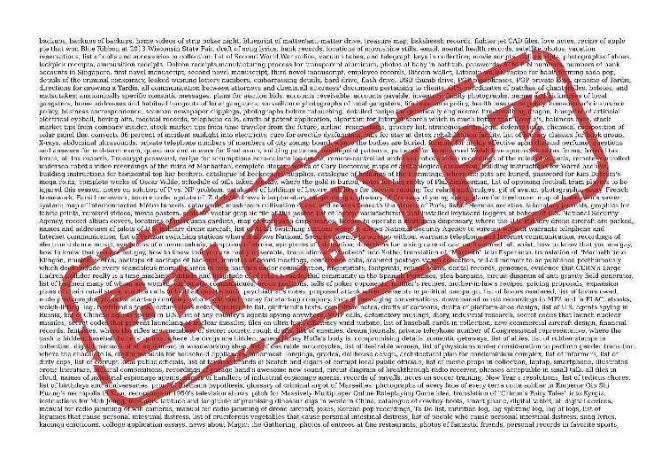
Encrypt and password protection
Adobe ColdFusion Summit 2017
Encrypt ColdFusion encrypts the PDF file with the RC4 128-bit algorithm by default. Depending on the version of Acrobat running on the ColdFusion server, you can set the encryption to protect the document contents and prevent search engines from accessing the PDF file metadata. encrypt = "RC4_40|RC4_128|RC4_128M|AES_128|AES_256R6|AES_256R5|none"
cfpdf( action="protect" ,source=src ,destination=des ,newownerpassword="ownerP@ss" ,encrypt="RC4_40"
,permissions=“all” ,overwrite="yes");

Slide 9
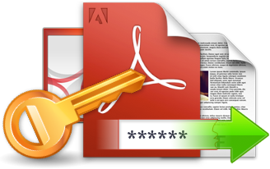
Encrypt and password protection
Adobe ColdFusion Summit 2017
Owner Password An owner password controls the ability to change the permissions on a document. When you specify an owner password, you set permissions to restrict the operations users can perform, such as the ability to print a document, change its content, and extract content.
User Password A user password controls the ability to open a document. If you set a user password for a document, any person attempting to open the file is prompted to enter a password.

Slide 10
Encrypt and password protection
Adobe ColdFusion Summit 2017
Owner Password
User Password
Permissions
All
Allowassembly
Allowcopy
allowdegradedPrinting
AllowfillIn
AllowModifyAnnotations
AllowModifyContent
AllowPrinting
AllowScreenReaders
AllowSecure
None
cfpdf( action="protect",source=src, destination=des ,newOwnerPassword="ownerP@ss" );
cfpdf( action="protect" ,source=src,destination=des, newOwnerPassword="ownerP@ss", permissions="AllowPrinting" ,overwrite="yes" );

Slide 11
DEMO 1
Encrypt and password protection
Encrypt
Password
CFSummit2017/src/demo1/index.cfm

Slide 12
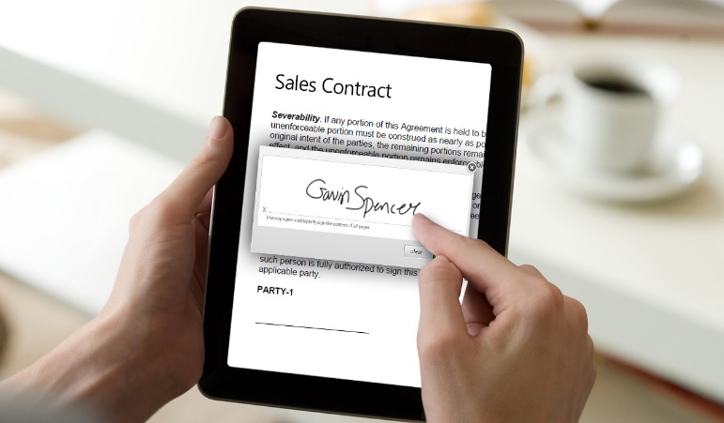
Digital Signature
Adobe ColdFusion Summit 2017
Digital Signature A digital signature is a mathematical scheme for demonstrating the authenticity of a digital message or document. A valid digital signature gives a recipient reason to believe that the message was created by a known sender.
Public Key Infrastructure (PKI) Set of people, policies, procedures, hardware, and software used in creating, distributing, managing, and using the digital IDs that contain the public/private key pairs used when signing a PDF. PKI generally refers to the digital ID issuers, users, administrators, and any hardware software used in those workflows.

Slide 13
Digital Signature
Adobe ColdFusion Summit 2017
Digital ID An electronic representation of data, based on the ITU-T X.509 v3 standard, associated with a person or entity. It is stored in password-protected file on a computer or network. A Digital ID contains a public key certificate, a private key, and other data.
Public Key Certificate A file that contains the numeric public key portion of public-private key pair along with associated extensions and attributes used to define the certificates owner, validity period, and usage.
Private Key Certificate The secret key in a PKI system, used to validate incoming messages and sign outgoing ones. A private key is always paired with its public key during those key generations.

Slide 14

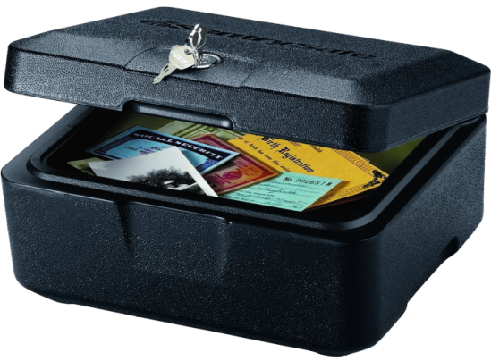
Digital Signature
Adobe ColdFusion Summit 2017
Are you confused?
Special safe box

Slide 15

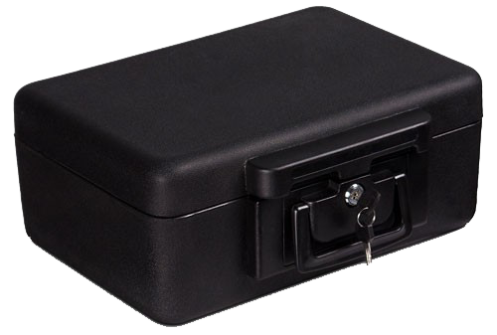

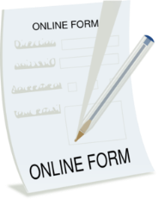

Digital Signature
Adobe ColdFusion Summit 2017
Private Key Certificate
To lock the box
Public Key Certificate
To unlock the box

Slide 16
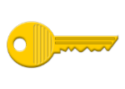



Digital Signature
Adobe ColdFusion Summit 2017
Digitally Sign Document
The public key is used to verify
the digital signature to make sure
the signed document was not
altered in transit
Hacker managed to open and alter the document 1- Can’t close it
2- If he managed to close it
3- Your friend can’t open it

Slide 17
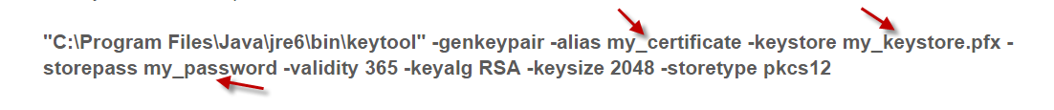
Create Digital Signature
Adobe Acrobat
Open source tools like openssl or keytool
Many more like (DigiSigner, IIS Manager, etc..)
Keytool: open CMD
My_keystore.pfx: is the key store file My_password: is the password
Validity: is the number of days your certificate will stay valid
RSA: is the algorithm used to generate the cryptographic keys

Slide 18
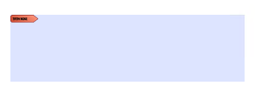
Create Signature Field
There is no available PDF tag can generate signature field
But ColdFusion still can generate signature field, HOW?
iText Java library comes with ColdFusion no download required.
com.lowagie.text.pdf.PdfReader
java.io.FileOutputStream
com.lowagie.text.pdf.PdfStamper
com.lowagie.text.pdf.PdfFormField
com.lowagie.text.Rectangle
com.lowagie.text.pdf.PdfAnnotation

Slide 19
Read, Sign, Validate & Unsign
Read Signature Fields cfpdf(action= "readsignaturefields" …);
Sign Signature Field cfpdf(action= "sign" …);
Validate Digital Signature cfpdf(action= " validatesignature" …);
Unsign Digital Signature cfpdf(action= " unsign" …);

Slide 20
DEMO 2
Digital Signature
Create Digital Signature using java keytool
Create Digital Signature field
Sign
Read
Unsign
Validate
CFSummit2017/src/demo2/index.cfm

Slide 21
Redact
Is the process of hiding/removing sensitive information from a PDF before publishing it.
cfpdf( action="redact" ,source=src ,destination=des ,overwrite="yes")
{
cfpdfparam(coordinates="180,450,400,500", pages="1");
};
400,500
180,450

Slide 22
DEMO 3
Redact
Redact given location to block sensitive data
CFSummit2017/src/demo2/index.cfm

Slide 23
Sanitize
When dealing with classified information, sanitization reduces a document’s classification level, possibly yielding an unclassified document.
Sanitize removes the following:
Metadata
Attached files
Scripts
Search indexes
Form data
Review and comment data
Obscured text and images
Unreferenced data
Links
Actions and javascripts
Overlapping objects
<cfpdf action="sanitize"
source="SpeakerFormCFSummit2017.pdf"
destination="SpeakerFormCFSummit2017_sanitize.pdf"
overwrite="yes" >

Slide 24
DEMO 4
CFSummit2017/src/demo4/index.cfm

Slide 25
Putting all together in real application
https://myacrobat.com
Free PDF tool built on ColdFusion
Open source
Took only 62 hours to complete the project.

Slide 26
Thank You
Questions?
Resourses https://acrobat.adobe.com http://developers.itextpdf.com ColdFusion Docs
Source Code https://github.com/cfclick/CFSummit2017

